Slide 1
National Conference on
“Applications of Artificial Intelligence in Engineering”
Gokhale Education Society's
R. H. Sapat College Of Engineering, Management Studies & Research
Prin. T. A. Kulkarni Vidyanagar, Nashik - 422 005, (M.S.)
“ Government JOB Portal ”
Student Names:
Apurva Dhawas
Shivam Singh
Kaustubh Joshi Guide Name
Prerana Chaudhari Dr.P.A.Chaudhari.
Department of MCA Engineering

Slide 2
Flow of Presentation
Introduction
Literature Survey
Concepts / Theory
  3.1 Details of Architecture/ Algorithms (if any)
  3.2 Description of Models /Methods
  3.3 Advantages and Disadvantages
  3.4 Applications/Uses
Conclusion
References

Slide 3
Introduction
"Find My Job" is a unique job portal application that has been created to assist individuals who are searching for employment opportunities. The application focuses on government jobs and organizes them into different categories based on age, language, and job type. This user-friendly platform allows users to access the latest job updates, application links, and detailed job descriptions.
Furthermore, the application provides study materials related to various exams such as JEE, NEET, and CET. It also includes links to exam forms along with relevant descriptions. This means that users can easily access resources and information related to entrance exams for different fields.
In today's highly competitive job market, job seekers often struggle to find reliable and comprehensive resources for their job search. The "Find My Job" project aims to solve this problem by offering a comprehensive platform tailored to the specific needs of job seekers. By providing categorized listings of government and private jobs, along with updated study materials, news updates about job opportunities, and information about entrance exams, the platform offers a centralized solution for individuals looking for employment.

Slide 4
Literature Survey
  In the context of online jobsites in Nepal we have come up with some relevant findings which are followed by later statements. According to the Central Bureau of Statistics 2014, a total of 4,000,200 people in Nepal is not getting jobs that match their skills and qualifications.
  The survey also reveals that 40,000 to 50,000 people who have a Bachelor’s degree is still unemployed. These figures affirm that finding a job of choice is not as easy it looks in Nepal. However, there are some ways that can help you to deal with this problem. And in this digital era, the best way you can approach to resolve this problem, at least to some extent, is through the internet to be specific through online job portals.

Slide 5
In the past few years, many Nepali online job portals have helped countless people to gain employment. I went through almost all of them and have compiled a list of the best Nepali job portals that have a good credence in the market and useful features on board. Here is the list of the five best Nepali job portals that you can use to start your next job hunt:
MeroJob
JobsNepal
KantipurJob
RamroJob

Slide 6
OBJECTIVES:
Develop a comprehensive platform that provides age wise and category-wise listings of government and private jobs.
Offer updated study materials and news related to job opportunities and entrance exams.
Provide links for free courses specifically tailored for entrance exam preparation.
Enable personalized notifications and alerts for new vacancies.
Gather feedback for continuous improvement.

Slide 7
Concepts /Theory
3.1 Details of Architecture
3.2 limitations
3.3 Benefits

Slide 8
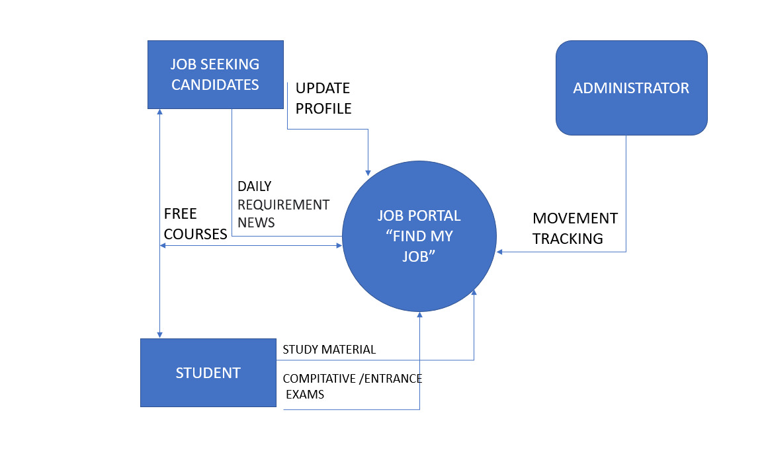
3.1 Details of Architecture

Slide 9
Working:
The working of a government job portal in a project typically involves several key components and functionalities. Here’s a overview of how a government job portal operate:
User Registration and Profile Creation:
Users can create an account on the government job portal by providing their personal information, contact details, and creating a username and password. This information is used to create their profile within the system.
Job Search and Filtering:
Users can search and filter job listings based on various criteria such as job category, location, qualifications, and experience level. The portal provides a search interface that allows users to find relevant job opportunities.
Notifications and Alerts:
The portal sends notifications and alerts to users regarding new job openings, changes in application status, upcoming deadlines, and other relevant information. These notifications can be sent via email, SMS, or through the portal's messaging system.

Slide 10
Exam Preparation Material:
In some cases, job portal websites may provide study materials and resources to help candidates prepare for specific exams or assessments required for certain job positions. These materials can include sample questions, practice tests, study guides, and reference materials links to support candidates' preparation efforts.
Feedback:
The portal may provide a user support system or a helpdesk feature to address user queries, technical issues, and offer guidance throughout the application process.
Security and Data Privacy:
Strong security measures are implemented to protect user data and ensure confidentiality. This includes encryption protocols, secure data storage, and compliance with relevant data protection regulations.
Maintenance and Updates:
Regular maintenance and updates are essential to ensure the smooth functioning of the portal. This includes bug fixes, security patches, and feature enhancements based on user feedback and changing requirements.

Slide 11
Benefits :
Wide Range of Opportunities: Online job portals provide access to a vast number of job opportunities from various industries and locations.
Convenience and Accessibility: Job seekers can search and apply for jobs anytime and anywhere, as long as they have an internet connection. Online job portals eliminate the need for physical visits or paper-based applications, making the process more convenient and accessible.
Time and Cost Savings: Online job portals save job seekers time and money by eliminating the need for traditional methods like newspaper ads or visiting multiple companies.
Enhanced Visibility and Reach: Online job portals enable job seekers to create professional profiles and upload their resumes, making them visible to a larger audience of employers and recruiters. This increases the chances of being discovered by potential employers and receiving relevant job offers.

Slide 12
Limitations
Limited Personalization: The limited personalization of job recommendations can also be seen as an advantage for job seekers who are exploring new career opportunities. It exposes them to a wider range of job listings and industries, potentially leading to the discovery of previously unknown or unconsidered job options.
Lack of Verification: Although the lack of verification is a limitation, it can also be advantageous for job seekers who are in the early stages of their careers or seeking career transitions. They may have acquired relevant skills or experiences outside of traditional credentials, online job portals give them the opportunity to showcase their abilities without strict validation criteria.
Reliance on Technology: While reliance on technology can be a limitation, it also provides advantages such as convenience, accessibility, and scalability. Online job portals allow job seekers and employers to connect regardless of geographical location, making it easier to explore opportunities

Slide 13
Conclusion :
The “GetJob" project aims to revolutionize the job search process by providing job seekers with a centralized platform for accessing relevant resources, simplifying document management, and staying updated on job opportunities and entrance exams. By addressing the limitations of existing systems, the proposed platform offers a comprehensive solution that streamlines the job search experience, and links to free courses for entrance exam preparation, the platform enhances job seekers' chances of success. Overall, “GetJob" has the potential to significantly impact the job search process, providing job seekers with a user-friendly and efficient solution.

Slide 14
References
Ramesh, P., & Malarvizhi, S. (2020). Challenges and Opportunities of Online Recruitment: A Study on Job Portals in India. Journal of Indian Business Research, 12(3), 305-325.
National Career Service (NCS): The NCS portal, developed by the Ministry of Labour and Employment, Government of India, is a comprehensive platform that provides a wide range of job opportunities, including government jobs. It offers job listings, career guidance, skill development courses, and other helpful resources. You can visit their website at https://www.ncs.gov.in/.
UPSC Online: The UPSC Online portal is managed by the Union Public Service Commission (UPSC), which conducts examinations for various government positions in India. The portal provides information about UPSC exams, application forms, exam schedules, results, and other relevant details. To access their services, you can visit https://www.upsc.gov.in/.

Slide 15
Thank you!!!

